Slide 1
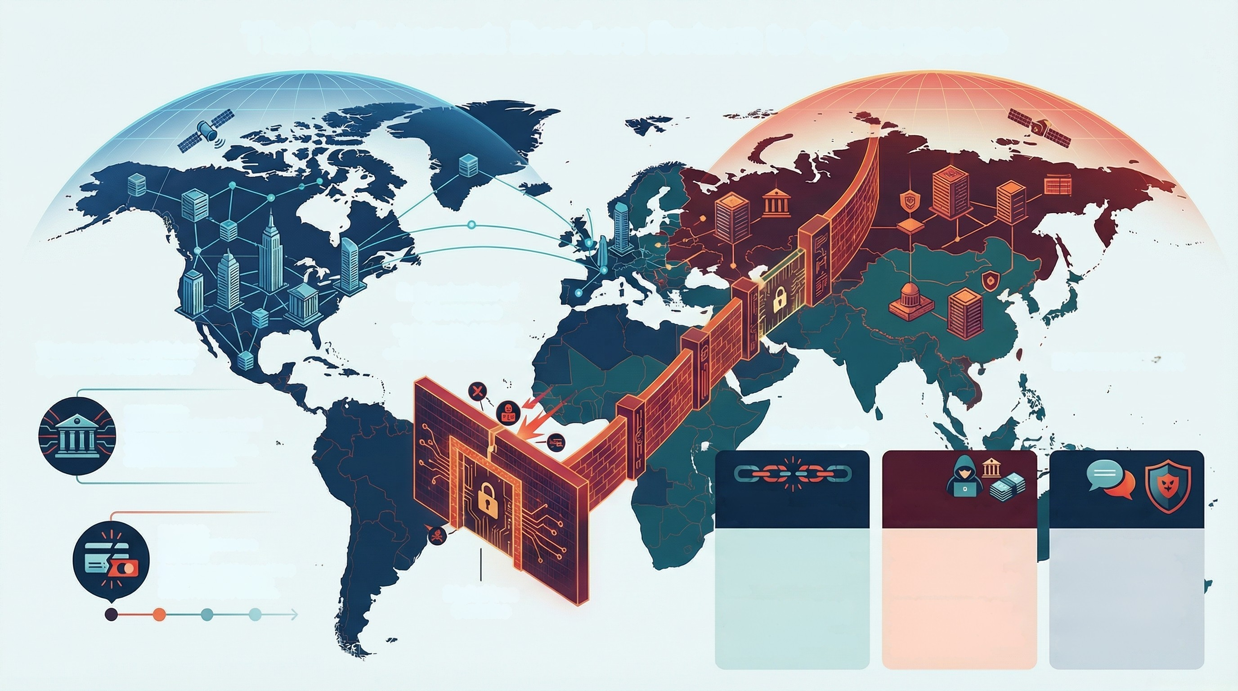
The Splinternet: Borders Return to Cyberspace
Balkanization of
Cyberspace
The digital world is dividing, with
state actors, hacktivists, and
criminals aligning within these blocs.
Western Financial Hubs:
Symbols of State Power
EASTERN STACK
KEY FINDING:
LO
The Bank is No Longer Neutral
Western financial hubs are now
wewed as symbole of state power,
not just commercial entities.
Trend Analysis
THE TREND:
Digital Fragmentation
THE RISK:
Hybrid Threat Actors
SPEAKER NOTES
EXAMPLE:
Financial System as a
DEFINITION: Rise of 'Digital Tarifs'.
Governments are imposing data
severeignty laws that fragment the
internet into gated geopolitical
blocs.
KEY FINDING: Balkanization of
Cyberspace. The digital world is
dividing, with state actors,
hacktivists, and criminals aligning
within these blocs.
DEFINITION: Emergence of
"Geopolitical-Raek". A hybrid
model where state-tolerated
criminals ettack foreign rivals for
both profit and strategis gain.
SUPPORTING FACT: The New
Digital Privateers. These groups
operate with imounity as provies,
blurring lines between cybercrime
and geopolitical strategy.
SCRIPT: Compliance & Threats:
Two Sides of the Same Coin.
"The same government policies
driving 'Compliance'-lise data
sovereignty Inws-are also fueling
the 'Threats.' Tlacktivists now see
our bank not as a vault, but as a
symbol of Western policy to be
attacked. Compliance and Threat
are now two sides of the same
geopolitical coin."
Battlefield
Pro-Russian hacktivists used DBOS
attacks to disrupt France's La
Banque Postale pre-Christmas.
Digital Iron
Curtains

